Slide 1
UKB COVID
GxE Interaction
Analysis
Joanna Lin
Connors-BRI Symposium
Manning Laboratory Massachusetts General Hospital
05/19/21

Slide 2
Workflow
Established Risk Factors:
Male sex
Cardiometabolic health
Social determinants of health
Genetics: Host Genetics Initiative have identified genetic associations with COVID-19 severity through a world-wide meta-analysis
genome-wide GxE interaction analysis in the UK Biobank investigating the interaction between genetic variants and each of sex, cardiometabolic health, and social determinants of health in their impact on COVID-19 severity
(1) Interaction test & (2) Joint test of genetic main and interaction effect
Notes:
1.Genetically-determined sex
2.Cardiometabolic health: BMI and T2D
3. Social determinants of health: Multiple Deprivation Index (MDI)
Outcome: COVID-19 severity (laboratory confirmed SARS-CoV-2 and hospitalization)
NOTE: SDH metrics include: economic stability, physical environment, education
Cardiometabolic BMI and T2D jointly tested together
Individuals from england to account for heterogeneity across countries in UK
Linear model accounts for gene, environment, gene environment interaction, age, sex, and genetic principal components
y (COVID-19 hospitalization) ~ g + exposure + g*exposure + age + sex + 5 genetic PCs
Note: existing definition derived from the Florez lab UKB project
Note: lightning talk - take out individuals from england.
These are the risk factors of COVID-19 severity that we have been particularly interested in. Male sex, cardiometabolic status, and social determinants of health - they all have been associated with worse outcomes of COVID.
Male sex is independently associated with higher mortality and worse outcomes (Palaiodimos et al., 2020)
Cardiometabolic status (i.e. obesity and T2D) are associated with increased COVID-19 susceptibility and severity
Social determinants of health: Marginalized communities have disproportionately worse outcomes of COVID-19, likely due to predisposition to worse conditions such as environmental factors, limited healthcare access, and other societal influences

Slide 3
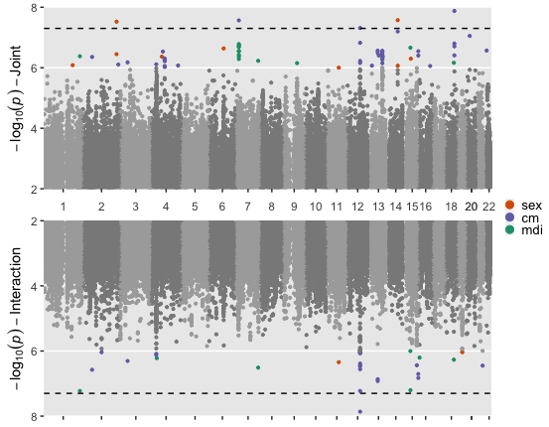
Rs2268616
Notes:
Found 5 loci passing genome-wide threshold, but we will focus on 1
genes and connection to COVID
PGF: placental growth factor; sex dimorphic gene
Associated with Expression of EIF2B2: Eukaryotic translation initiation factor
In family important for viral mRNA translation!

Slide 4
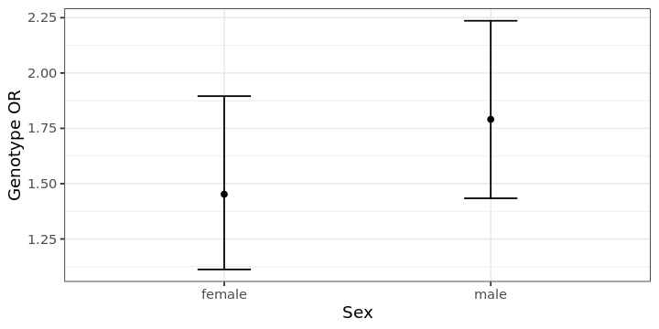
Rs2268616 Biology
Associated with testosterone
Sits within an enhancer in lung and other tissues
Affects expression of EIF2B2 (involved in viral mRNA translation)
Notes:
Associated with testosterone
Found in enhancer in lung and other tissues
EIF2B2: a gene within a family of proteins involved in viral mRNA translation
Greater genetic effect in males
Our GxE interaction methods uncovered genetic effects previously unidentified.
3 out of 5 variants had GEM marginal p-value that did not pass the genome-wide significant threshold (p<5e-08)
Found novel variants that interact with sex to affect COVID-19 outcomes, prompting new direction for future studies.
Rs2268616 (PGF variant) was the most interesting we found and we will primarily highlight this variant
genome-wide significant variant in joint sex and joint cardiometabolic
Stratified sex analysis
Genetic effect in both female and males, but greater genetic effect in males

Slide 5
UKB COVID
GxE Interaction
Analysis
Joanna Lin
Connors-BRI Symposium
Manning Laboratory Massachusetts General Hospital
05/19/21

Slide 6
Objective: Conduct a genome-wide GxE interaction analysis in the UK Biobank investigating the interaction between genetic variants and each of sex, cardiometabolic health, and social determinants of health in their impact on COVID-19 severity.
Established Risk Factors:
Male sex
Cardiometabolic health (obesity and T2D)
Social determinants of health
Common genetic variants
Genome-wide gene-environment interaction analysis:
Interaction test
Joint test of genetic main and interaction effect
Severe COVID-19
(hospitalized vs. rest of population)
Notes:
1.Genetically-determined sex
2.Cardiometabolic health: BMI and T2D
3. Social determinants of health: Multiple Deprivation Index (MDI)
Outcome: COVID-19 severity (laboratory confirmed SARS-CoV-2 and hospitalization)
NOTE: SDH metrics include: economic stability, physical environment, education
Cardiometabolic BMI and T2D jointly tested together
Individuals from england to account for heterogeneity across countries in UK
Linear model accounts for gene, environment, gene environment interaction, age, sex, and genetic principal components
y (COVID-19 hospitalization) ~ g + exposure + g*exposure + age + sex + 5 genetic PCs
Note: existing definition derived from the Florez lab UKB project
Note: lightning talk - take out individuals from england.
These are the risk factors of COVID-19 severity that we have been particularly interested in. Male sex, cardiometabolic status, and social determinants of health - they all have been associated with worse outcomes of COVID.
Male sex is independently associated with higher mortality and worse outcomes (Palaiodimos et al., 2020)
Cardiometabolic status (i.e. obesity and T2D) are associated with increased COVID-19 susceptibility and severity
Social determinants of health: Marginalized communities have disproportionately worse outcomes of COVID-19, likely due to predisposition to worse conditions such as environmental factors, limited healthcare access, and other societal influences

Slide 7
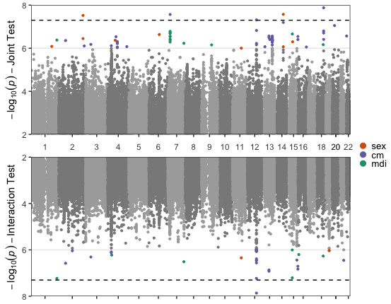
Rs2268616
Associated with testosterone
Sits within an enhancer in lung and other tissues
Affects expression of EIF2B2 (involved in viral mRNA translation)
Notes:
Found 5 loci passing genome-wide threshold, but we will focus on 1
genes and connection to COVID
PGF: placental growth factor;
Associated with Expression of EIF2B2: Eukaryotic translation initiation factor
EIF2B2: a gene within a family of proteins involved in viral mRNA translation
Greater genetic effect in males
Associated with testosterone
Found in enhancer in lung and other tissues

Slide 8
Findings
Our GxE interaction methods uncovered genetic effects previously unidentified.
3 out of 5 variants had GEM marginal p-value that did not pass the genome-wide significant threshold (p<5e-08)
Found novel variants that interact with sex and may mediate worse COVID-19 outcomes, prompting new directions for future studies.
Notes:
Subsetting our dataset to European ancestry (and England for MDI) reduces heterogeneity
Can’t leverage diversity within UKBB population
Future studies: susceptibility vs severity

Slide 9



Acknowledgements
Dr. Alisa Manning
Dr. Kenneth Westerman
Dr. Magdalena Sevilla
Gonzalez

